Slide 1
Competitive Programming
Andrei Novikov
23 Feb. 2024

Slide 2
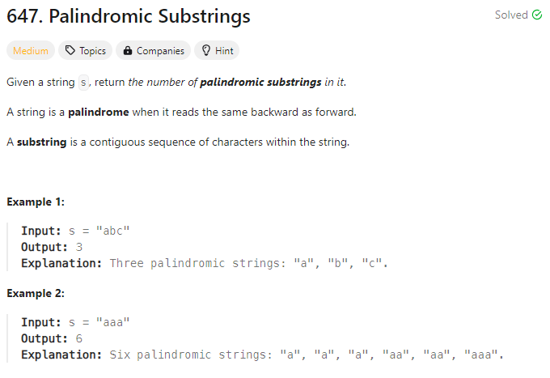

Dynamic Programming #1
LeetCode – 647 Palindromic Substrings - Link

Slide 3
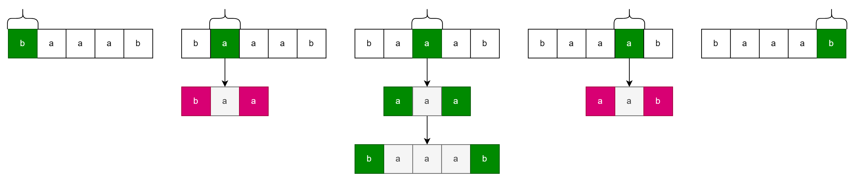
Palindromic Substrings – DP Approach
LeetCode – 647 Palindromic Substrings - Link
Every character consider as a center of growing palindrome.
Grow the palindrome as an odd…

Slide 4
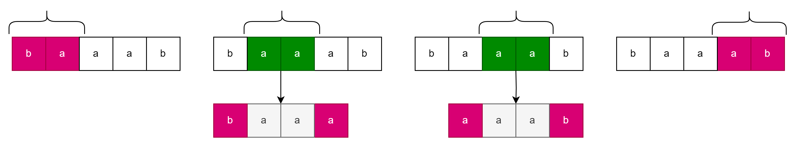
Palindromic Substrings – DP Approach
LeetCode – 647 Palindromic Substrings - Link
Every character consider as a center of growing palindrome.
Grow the palindrome as an odd and as even like here.

Slide 5
Palindromic Substrings - Implementation
LeetCode – 647 Palindromic Substrings - Link
Share the screen and solve the task together

Slide 6
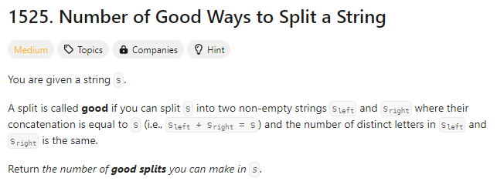
Dynamic Programming #2 – Is not it?
LeetCode – 1525 Number of Good Ways to Split a String - Link

Slide 7
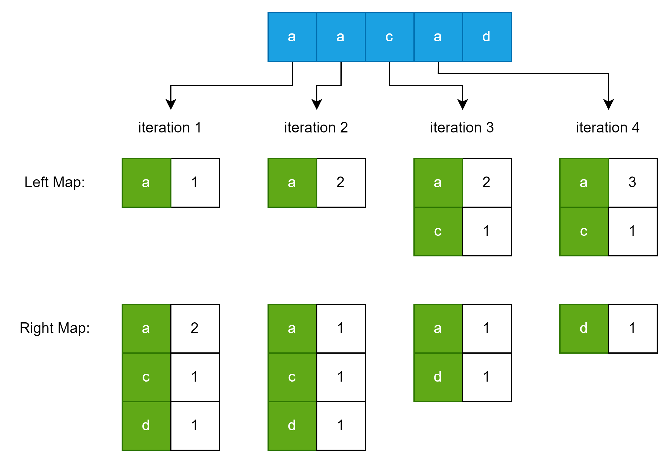
Dynamic Programming #2 - Approach
LeetCode – 1525 Number of Good Ways to Split a String - Link

Slide 8
Dynamic Programming #2 - Approach
LeetCode – 1525 Number of Good Ways to Split a String - Link
Share the screen and solve the task together

